Slide 1

Detection of Parkinson’s Disease using Machine Learning
Team Lead : V.I.Maneesh Vijay
Team Members : K.Hariharan, M.S.Sivakumar, M.Kishore Kumar
Team ID : PNT2022TMID04005

Slide 2
INTRODUCTION
Parkinson Disease is a brain neurological disorder. It leads to shaking of the body, hands and provides stiffness to the body. No proper cure or treatment is available yet at the advanced stage. Treatment is possible only when done at the early or onset of the disease. These will not only reduce the cost of the disease but will also possibly save a life. Most methods available can detect Parkinson in an advanced stage; which means loss of approx.. 60% dopamine in basal ganglia and is responsible for controlling the movement of the body with a small amount of dopamine. More than 145,000 people have been found alone suffering in the U.K and in India, almost one million population suffers from this disease and it’s spreading fast in the entire world.

Slide 3
ABSTRACT
More than 10 million people are living with Parkinson’s Disease worldwide, according to the Parkinson’s Foundation. While Parkinson’s cannot be cured, early detection along with proper medication can significantly improve symptoms and quality of life.
The researchers found that the drawing speed was slower and the pen pressure is lower among Parkinson’s patients. One of the indications of Parkinson’s is tremors and rigidity in the muscles, making it difficult to draw smooth spirals and waves. It is possible to detect Parkinson’s disease using the drawings alone instead of measuring the speed and pressure of the pen on paper. Our goal is to quantify the visual appearance(using HOG method) of these drawings and then train a machine learning model to classify them. In this project, We are using, Histogram of Oriented Gradients (HOG) image descriptor along with a Random Forest classifier to automatically detect Parkinson’s disease in hand-drawn images of spirals and waves

Slide 4
OBJECTIVE
You’ll be able to understand the problem to classify if it is a regression or a classification kind of problem.
You will be able to know how to pre-process the image by using different data pre-processing techniques.
you will be able to learn how to use OpenCV and machine learning to automatically detect Parkinson’s disease in hand-drawn images of spirals and waves
You will be able to know how to find the accuracy of the model.
You will be able to build web applications using the Flask framework.

Slide 5
PROJECT FLOW
User interacts with the UI (User Interface) to upload the image as input
The uploaded image is analyzed by the model which is integrated
Once the model analyzes the uploaded image, the prediction is showcased on the UI and OpenCV window
To accomplish this, we have to complete all the activities and tasks listed below
Data Collection
Collect the dataset or Create the dataset
Image Preprocessing.
Importing the required libraries
Loading Train data and Test data
Quantifying images
Label Encoding
Model Building
Training the model
Testing the model
Model Evaluation
Saving the model
Application Building
Create an HTML file
Build Python Code

Slide 6
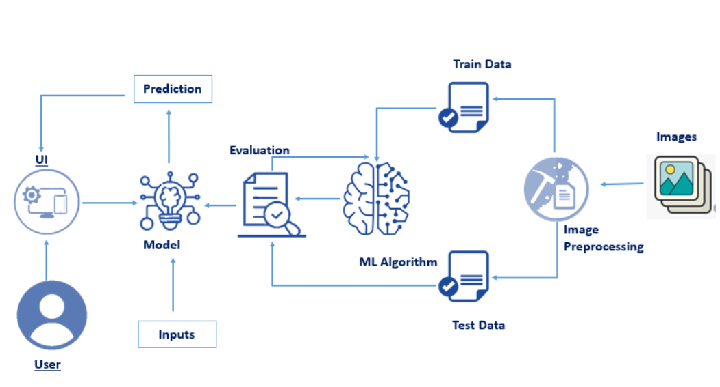
TECHNICAL ARCHITECTURE AND PRE-REQUISITES

Slide 7
Anaconda navigator is a free and open-source distribution of the python and R programming languages for data science and machine learning related applications. It can be installed on windows, linux, and macos. Conda is an open-source, cross-platform, package management system. Anaconda comes with so very nice tools like jupyterlab, jupyter notebook, qtconsole, spyder, glueviz, orange, rstudio, visual studio code. For this project, we will be using jupyter notebook and spyder to build machine learning models you must require the following packages numpy: it is an open-source numerical python library. It contains a multidimensional array and matrix data structures and can be used to perform mathematical operations scikit-learn: it is a free machine learning library for python. It features various algorithms like support vector machine, random forests, and k-nearest neighbours, and it also supports python numerical and scientific libraries like numpy and scipy scikit-image scikit-image or skimage, is an open-source python package designed for image preprocessing. Install imutils imutils are a series of convenience functions to make basic image processing functions such as translation, rotation, resizing, and displaying matplotlib images easier with opencv open anaconda prompt and type this command “pip install imutils” opencv opencv is a library of programming functions mainly aimed at real-time computer vision. Here, opencv is used to capture frames by accessing the webcam in real-time. Open anaconda prompt and type this command “pip install opencv-contrib-python” flask: web framework used for building web applications

Slide 8
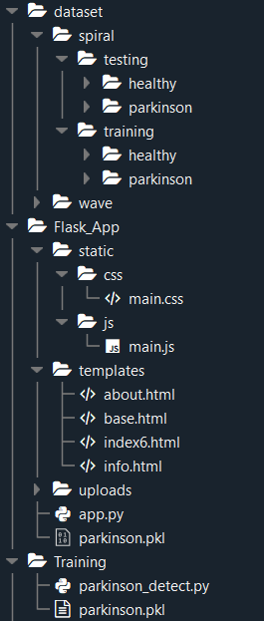
PROJECT STRUCTURE
Training folder contains:
Parkinson_detect.py
model file “parkinson.pkl”
Flask App folder contains:
static folder with the style sheets and the image required
templates folder with the HTML pages
app.py, a python script (Flask file) for server side computing.

Slide 9
CONCLUSION
Parkinson’s disease affects the CNS of the brain and has yet no treatment unless it’s detected early. Late detection leads to no treatment and loss of life. Thus its early detection is significant. For early detection of the disease, we utilized machine learning algorithms such as XGBoost and Random Forest. We checked our Parkinson disease data and find out XGBoost is the best Algorithm to predict the onset of the disease which will enable early treatment and save a life.

